Slide 1
One-Click (serverless project)
Production Support Team, SAP
June 20, 2019

Slide 2





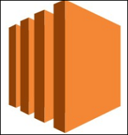


Replacement of traditional systems
Source
Build
Deploy
A fully managed service hosted by AWS
Store your code securely
Work collaboratively on code
Easily scale your version control projects
Easily migrate files from other remote repositories
Compiles source code, runs tests, and produces software packages that are ready to deploy.
Don’t need to provision, manage, and scale your own build servers
Code Build scales continuously and processes multiple builds concurrently
Automates code deployments to any instance, including Amazon EC2 instances and on-premises servers
Rapidly release new features, helps you avoid downtime during application deployment, and handles the complexity of updating your applications
{CodePipeline}
{Developer}
{User}
{CodeCommit}
{CodeBuild}
{CodeDeploy}
{EC 2}
{S3 Bucket}

Slide 3
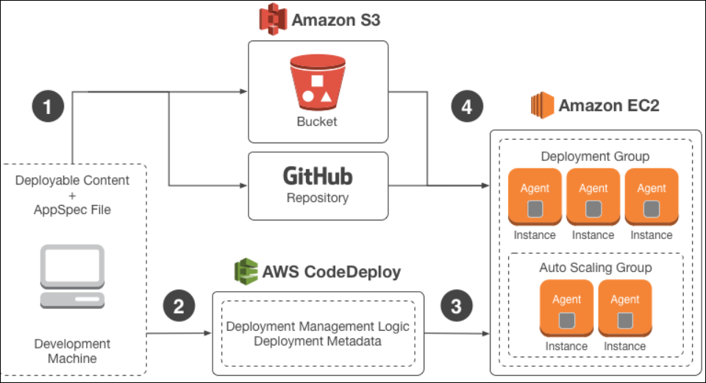
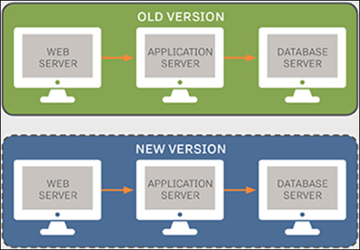
Two Types of Deployments – Deploy in place & Blue, Green Deployment
{Deploy in place}
{Blue, Green Deployment}
Updates the instances in the deployment group with the latest application, revisions and each instance will be briefly taken offline for its update.
Replaces the instances in the deployment group with new instances and deploys
the latest application revision to them. After instances in the replacement environment
are registered, instances from its original environment are deregistered and can be
terminated.

Slide 4
Key advantages-
No server management
Pay as you use
Inherently scalable
Quick deployments and updates
Reduce latency

